Slide 1
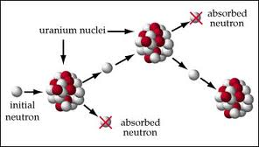
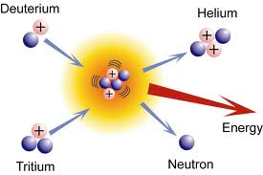
Nuclear reaction is the change in the identity or characteristics of an atomic nucleus. Nuclear reaction is the process in which 2 nuclei, or nucleus and a subatomic particle collide to produce products different from the initial particles or when nucleus decay to decrease its energy and become more stable.

Slide 2
Types of nuclear reactions:
Fission – splitting of a nucleus into “daughter” nuclei.
Fusion – combining two parent nuclei into one nucleus
Neutron capture
Decay

Slide 3
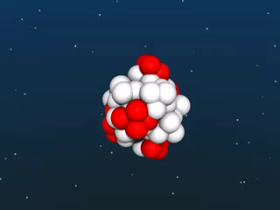
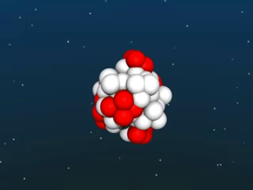
Fission reaction

Slide 4
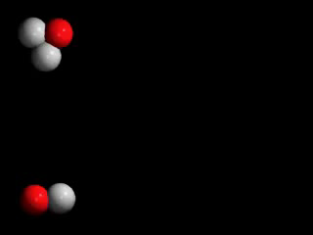
Fusion reaction

Slide 5
Atomic unit of mass = 1.660559x
= 1/12 of carbon-12
Mass of proton = 1.6726x
= 1.007276u
Mass of neutron = 1.6750x
= 1.008665u

Slide 6
1u ≡ 931.494 MeV/
A = Z + N
E(Mev)=[ZMp + NMn – M( )] x 931.494 MeV/u
M(α) = 4.002603u
2Mp + 2Mn = 4.031882u
E = ∆M x = 27.27MeV

Slide 7
M(U) = 238.03u
92Mp + 146Mn = 239.93u
E = 1769.84Mev
For helium E/A = 6.8Mev
For uranium E/A = 7.4MeV

Slide 8
What is binding energy? When 2 bodies stick together, we need to provide energy to separate them. If we take 2 free objects and get bound as they are brought together, energy will be released. This energy called binding energy. The mass of the bound system decreases and system is in the lower energy state.

Slide 9
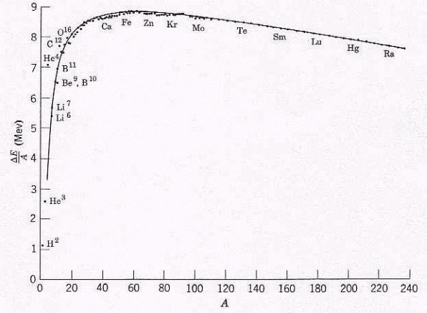

Slide 11
